Slide 1
Health App – UML Diagrams - Team 4

Slide 2
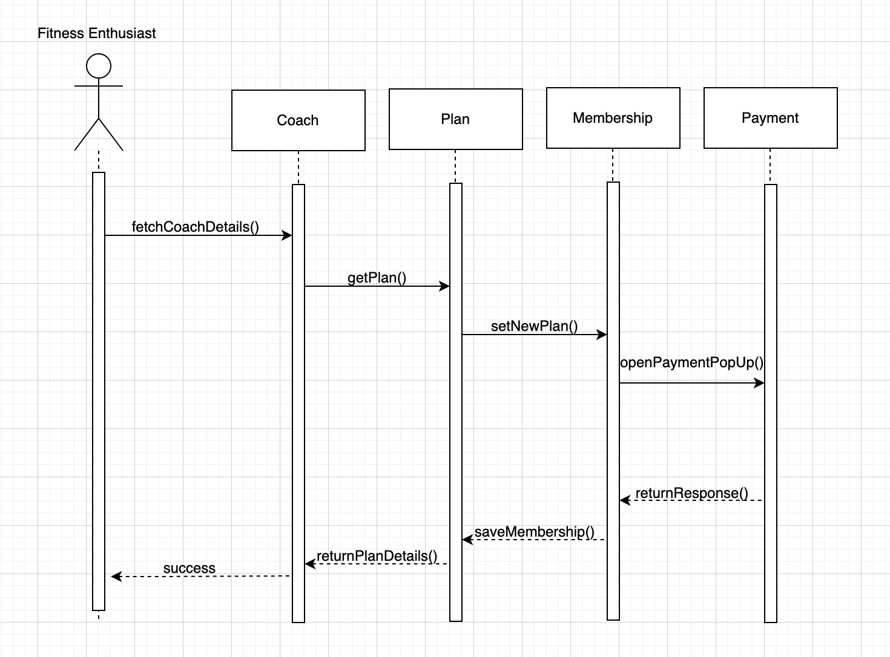
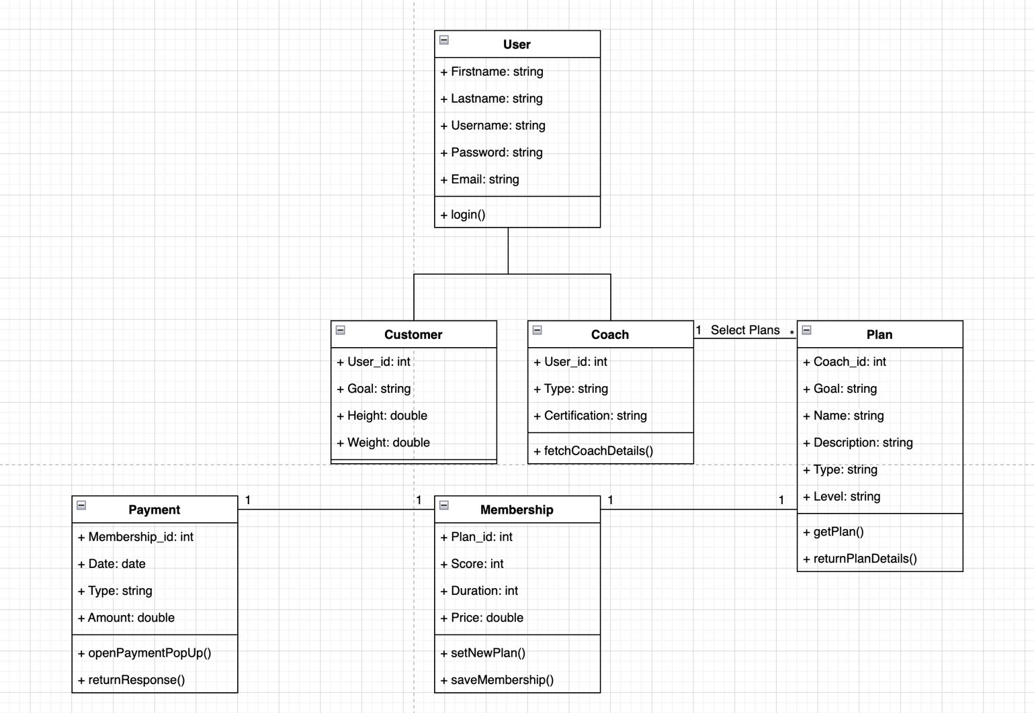
Use Case – 04.02 Subscribe Coach

Slide 3
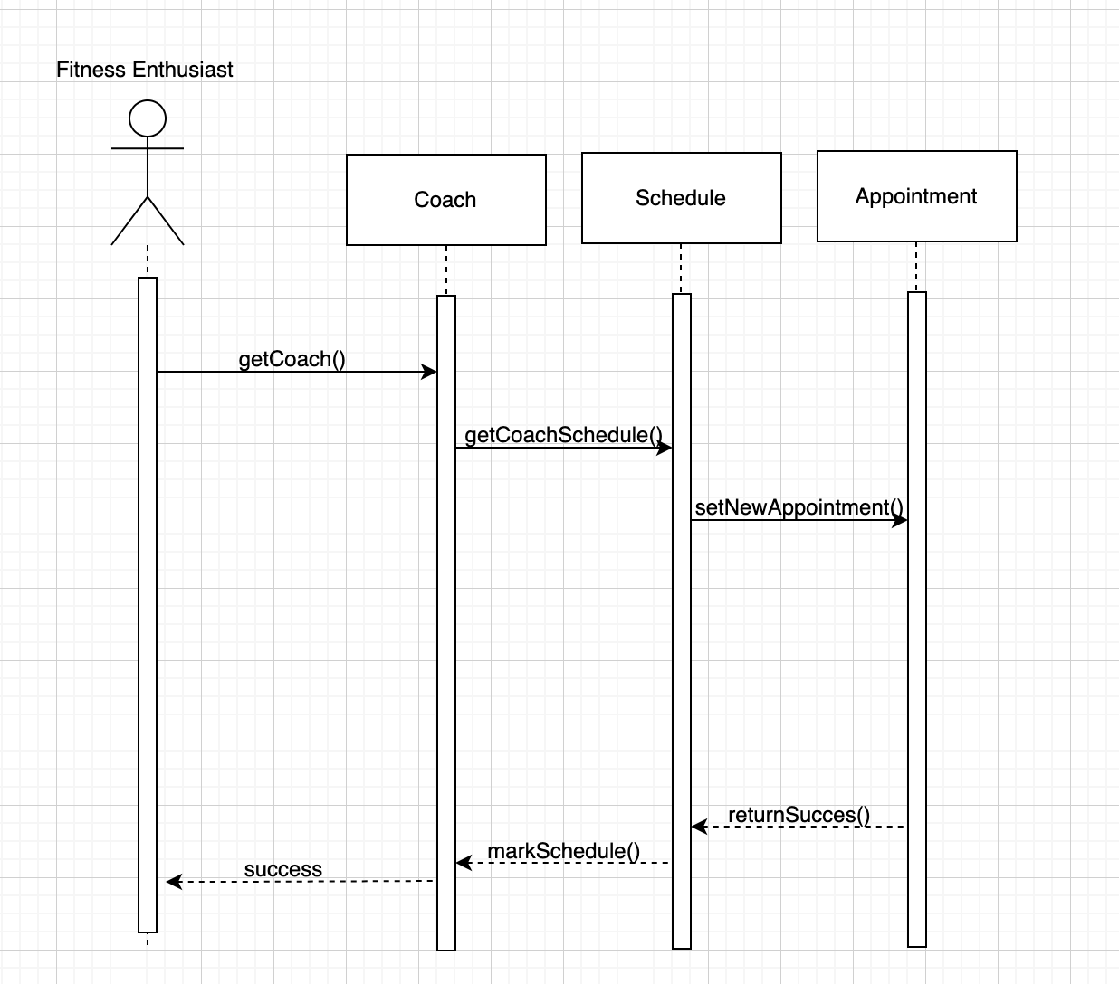
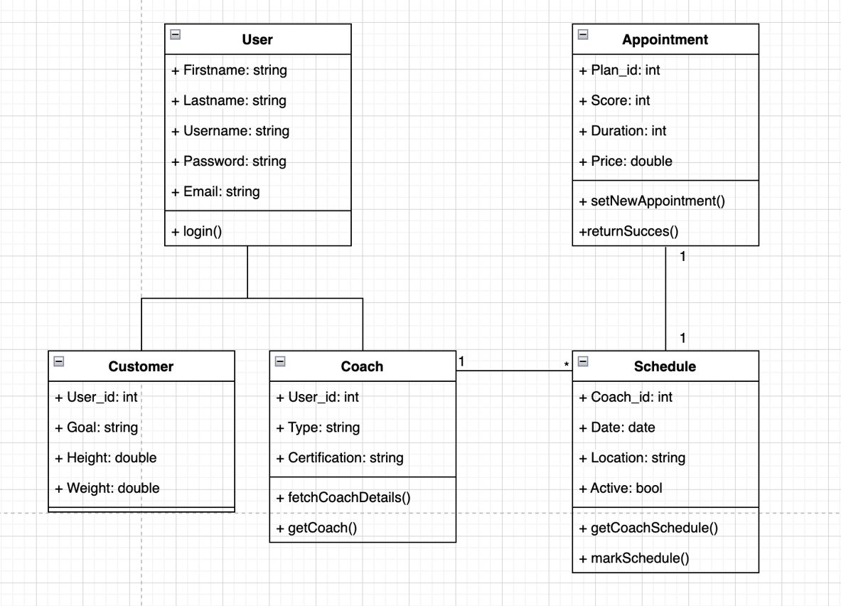
Use Case – 04.03 Schedule Appointment

Slide 4
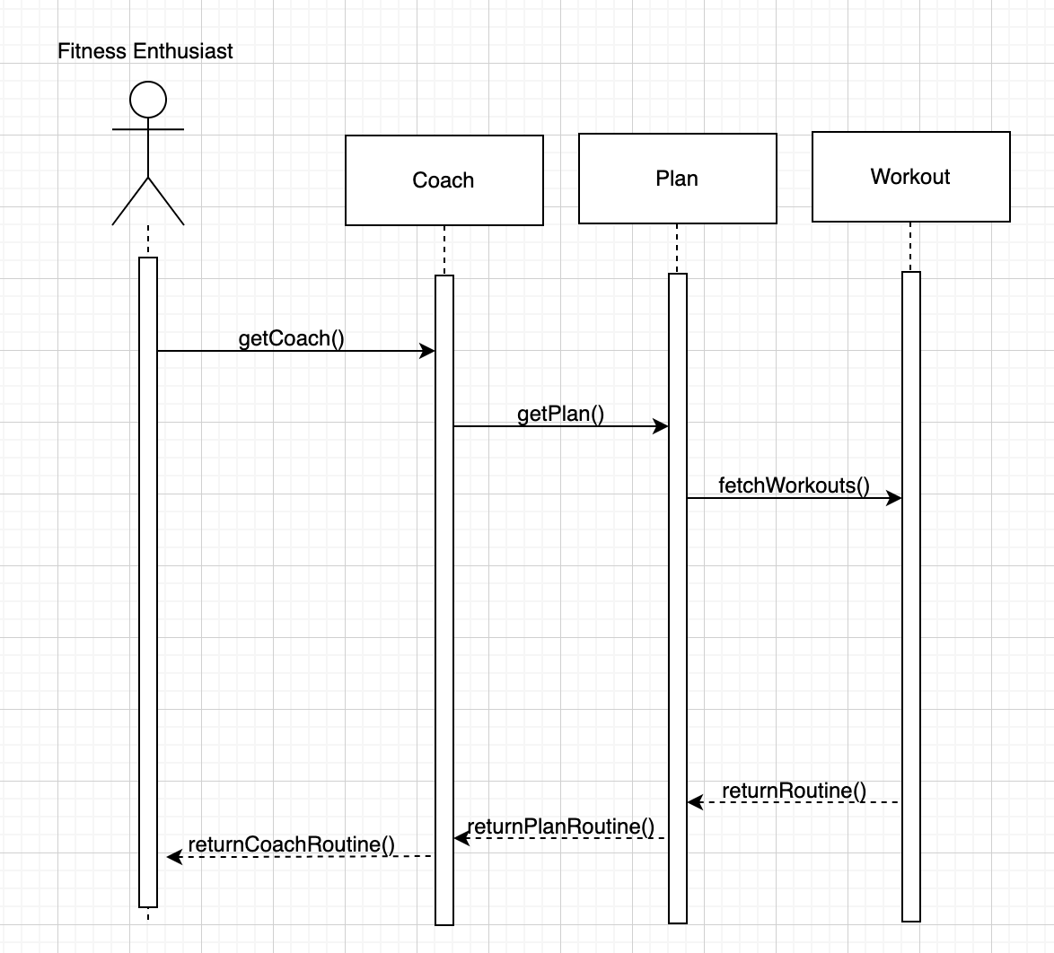
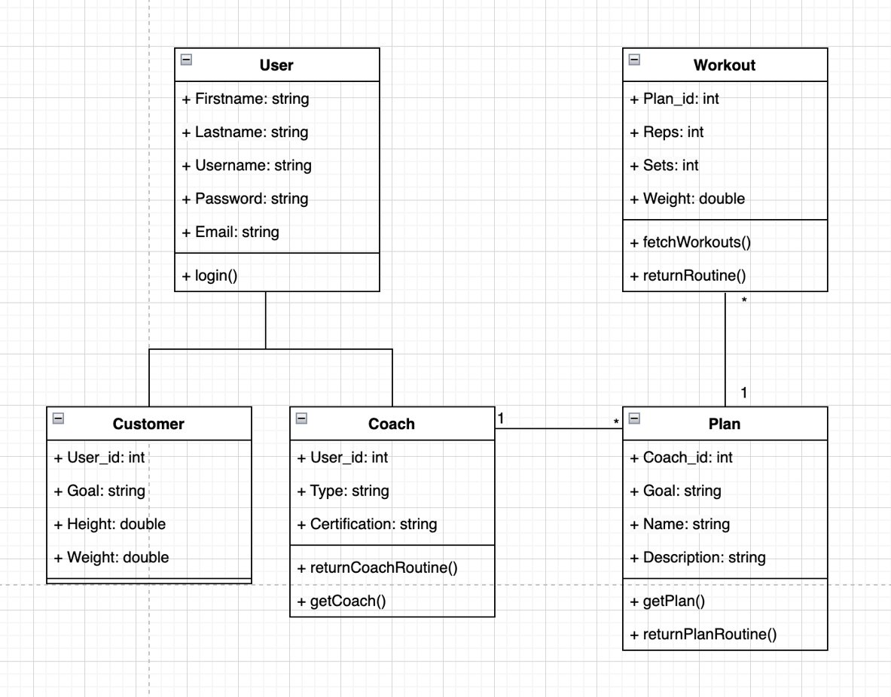
Use Case – 04.04 Access Routine

